Slide 1
Communications Subsystem (Comms)
Austin Macosky – Communications Subsystem Lead

Slide 2
Outline
Mission Overview
Responsibilities
Data requirements and abilities
Passes per day and orbit
Link Budget
System Overview
Important requirements
Communication system overview
Uplink encryption and station licensing
Subsystem Design
Satellite
Ground Station

Slide 3
Mission Overview
Uplink:
OBC – Commands for bus systems and payloads
Transceiver – Reconfiguration in orbit
Downlink:
OBC – Compiled health and science data

Slide 4
Orbit and Passes Per Day
System designed for ISS orbit
400-435 km
16 orbits per day
>3 usable passes per day on average

Slide 5
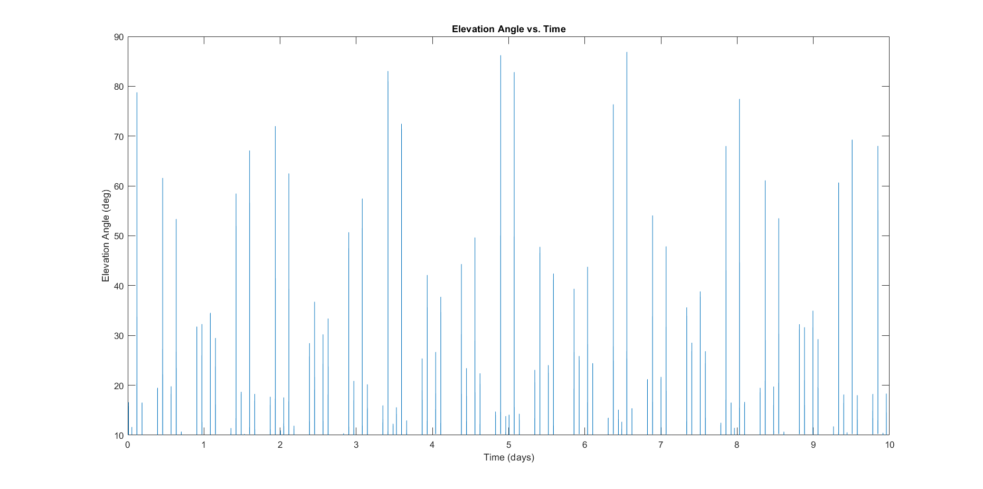
ISS Passes > 10° For 10 days
Fig COMM-1: 10-day Visibility Forecast

Slide 6
Data Requirements
Subsystem | Data/Cycle | Cycles/Day | Data/Day
CRP | 8 kB | 16 | 128 kB
MDE | 8 kB | 16 | 128 kB
OBC | 8 kB | 4 | 32 kB
Total Data Per Day
288 kB

Slide 7
Data Capabilities
Total data for uplink and downlink combined
Data rate | Data per 3-minute pass | Data per day (8 minutes)
19.2 kbps | 432 kB | 1.15 MB
100 kbps | 2.25 MB | 6 MB

Slide 8
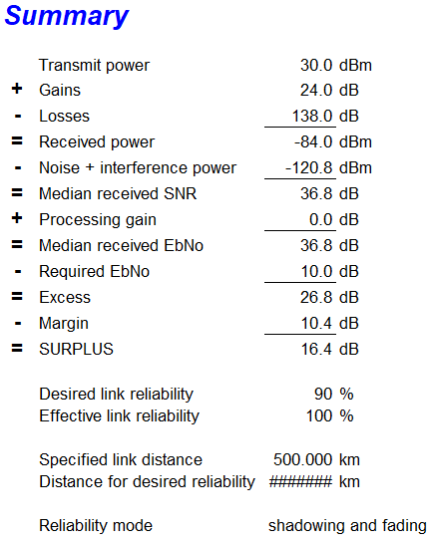
Link Budget
NIST Communications Group Link Budget Calculator

Slide 9





System Overview
USB 3
Coax
Coax
UART
Ground Station Computer
Ground Station Transceiver
Ground Station Antenna
Satellite Antenna
Satellite Transceiver
Onboard Computer
Fig COMM-7: System Communication Diagram

Slide 10
Station Licensing
FCC Part 97.207 (f) "Space telemetry transmissions may consist of specially coded messages intended to facilitate communications or related to the function of the spacecraft."
Verified 'specially coded' = encrypted
FCC Part 97.211 (b) "A telecommand station may transmit special codes intended to obscure the meaning of telecommand messages to the station in space operation."
These sections apply if:
The space station is located more than 50 km above the Earth's surface (FCC Part 97.3(41))
The data being downlinked is "measuring instruments in a spacecraft including those related to the functioning" (FCC Part 97.3 (42)
The transmissions are coming from an 'amateur station that transmits communications to a space station (FCC Part 97.3(45)

Slide 11
Station Licensing
FCC Part 97.313 "An Earth station or telecommand station, however, may transmit on the 435-438 MHz segment with a maximum of 611 W effective radiated power (1 kW equivalent isotropically radiated power) without the authorization otherwise required. The transmitting antenna elevation angle between the lower half-power (?3 dB relative to the peak or antenna bore sight) point and the horizon must always be greater than 10°".
We will be applying for a station power waiver if necessary
Granted for ES1 (may be frequency specific)

Slide 12
IARU Frequency Coordination
Frequency coordination request will be submitted to both the FCC and IARU
Current issues
Other CubeSats have had launches scrubbed due to frequency coordination issues
Government power struggle over frequency coordination
Cannot complete paperwork until manifested

Slide 13
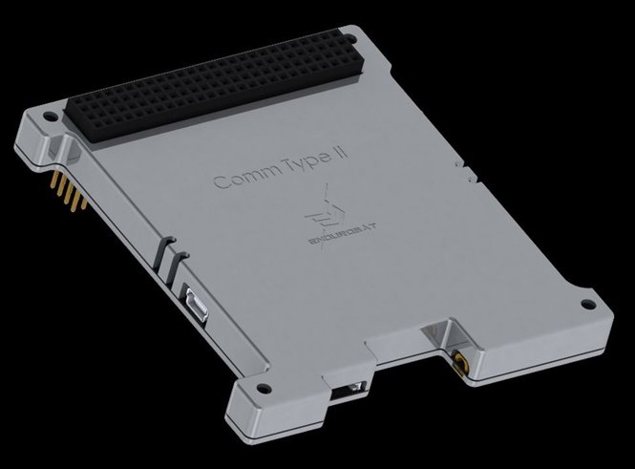
EnduroSat UHF Transceiver Type II
Configurable data rate
19.2 kbps
100 kbps
1-Watt RF output
Transparent protocol
Allows custom packet format
High sensitivity receiver –121dBm
Spectrally efficient 2GFSK modulation
94 g
Software updates and reconfiguration in orbit
Fig COMM-8: UHF Transceiver Type II

Slide 14
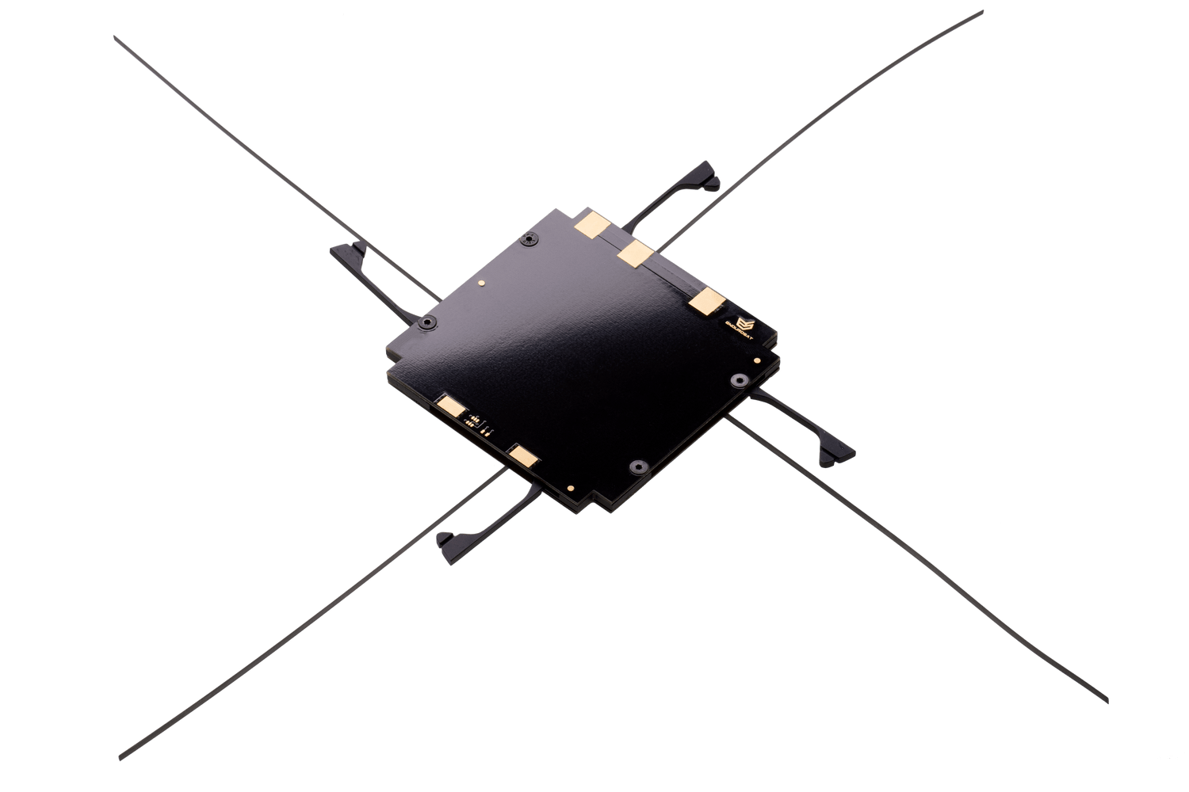
EnduroSat UHF Antenna
Circularly polarized dipole array
Rejects reflected signals
1.1dBi maximum gain
-2dBi minimum gain
Acceptable omnidirectional backup performance
Antenna deployment feedback
Thin enough to mount below -z crossmember
500 mA deployment current
Isolated burn circuit for each element
Backup burn resistor for each element
Fig COMM-9: UHF Antenna

Slide 15
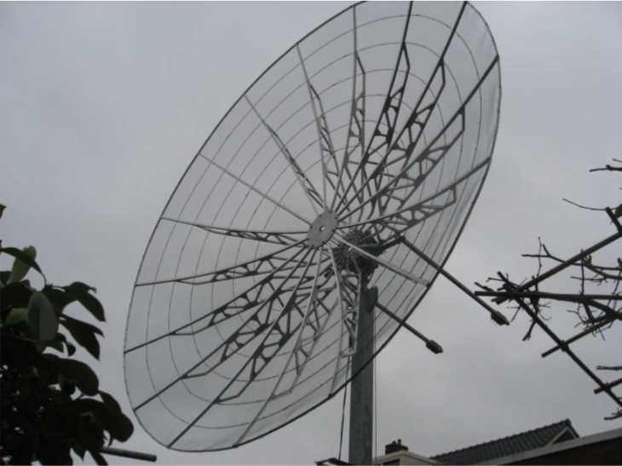
Subsystem Design (Ground Station)
RF HamDesign Satellite Ground Station Kit
4.5m parabolic dish
24dbi gain @ 435 MHz
10.5 degree –3dB beam width
BIG-RAS azimuth and elevation rotator
Dishes up to 5m
0.5-degree resolution
MD-02 rotator controller
1-degree resolution
Emulates Yeasu products (compatibility)
Custom multiband feed point
Primary band 435Mhz
LMR600 coax
High-speed desktop
DSP using GNU Radio
Fig COMM-11: AxFab Antenna

Slide 16
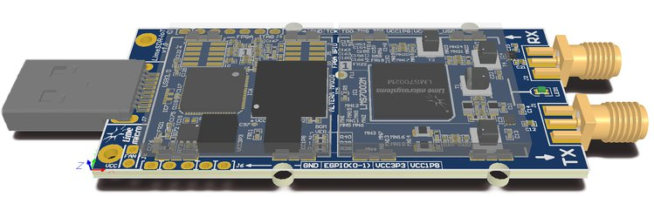
Ground Station Transceiver
LimeSDR Mini
Maximum 30.72 MSPS
Full duplex
Frequency range: 10 Mhz – 3.5Ghz
12 bit DAC
SMA connectors
USB 3.0
DSP with GNU Radio
Allows for high data throughput
Cataloging & capturing passes
Fig COMM-12: LimeSDR Mini

Slide 17

GNU Radio
Downlink
Capture raw waveform of pass
Demodulate downlinked data
Catalog and store pass data autonomously
Uplink
Interface with satellite control GUI
Modulate commands
Doppler shift correction
Transmit
Fig COMM-16: GNU Radio Logo

Slide 18
Questions?
Austin Macosky
MacoskyA@my.erau.edu

